Slide 1
JPI Urban Europe
Transition Towards Sustainable
& Liveable Urban Futures
Margit Noll
JPI Urban Europe Management Board
margit.noll@jpi-urbaneurope.eu
Notes:
Add your own name and date

Slide 2
Cities & Urban Areas in Europe
75% of European population lives in cities
Climate change mitigation
Resilience
80% GDP is produced in cities
80% of CO2 emission are generated in cities
Unemployment and social segregation
Hubs for migration & innovation
Austerity & economic growth
Biggest cities have younger population
Half of the cities are between 50 000 and 100 000 inhabitants
Migration & social dynamics
Governance and societal engagement
Dense city network and unique urban heritage

Slide 3
Urban development high on the political agenda
UN-HABITAT
  emphasizes to strengthen urbanization as the engine for sustainable development
  demands to overcome the current unsustainable model of urbanization
The European Urban Agenda
  requests new conditions to achieve inclusive, people-centered and sustainable global development
  calls for an integration and better coordination of policies across sectors
  demands to deliver results such as smart cities, improve urban intelligence and provide new urban data

Slide 4
Joining Efforts in Europe
EIP Smart Cities & Communities
EU urban agenda
H2020
Cohesion &
Structural Funds
JPI Urban Europe
Providing evidence for the European urban agenda
Building critical masses and aligning national competences and programs
Complementing smart city flagship initiatives
Realising a new paradigm in urban research & innovation
National RDI prorammes
Cities
Local initiatives
Research organisations
Industry & SMEs

Slide 5
A new paradigm in urban research & innovation
Enhancing cities’ capacities for transition
Tackling the complexity of urban development and sustainability
Teaming up with cities and urban stakeholders
Raising the impact and supporting the exploitation of technological and social innovation

Slide 6
Instruments
Joint Calls
Alignment of
research
organisations
UERA
Alignment of
research
infrastructure
Alignment of
national programs
Program management
Strategic dialogue
& international outreach
Living labs, urban observatories & databases
Cooperation
with H2020,
JPIs and other networks
Platform for valorisation & dissemination

Slide 7
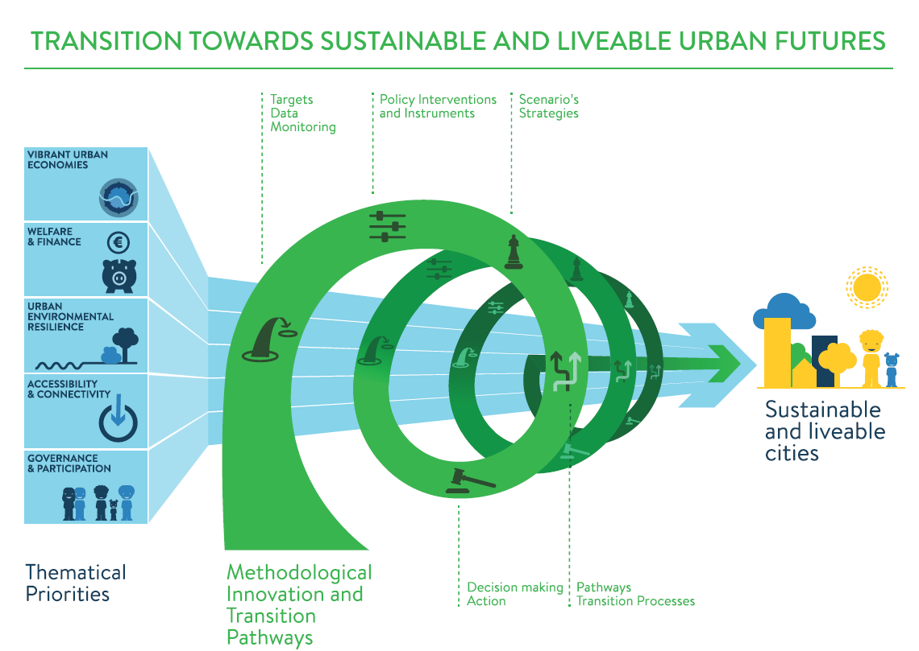

Slide 8
JPI Urban Europe
Research and Innovation Agenda for Urban Transition
Margit Noll
JPI Urban Europe Management Board
margit.noll@jpi-urbaneurope.eu

