Slide 1
ERA-NET Cofund Smart Urban Futures

Slide 3
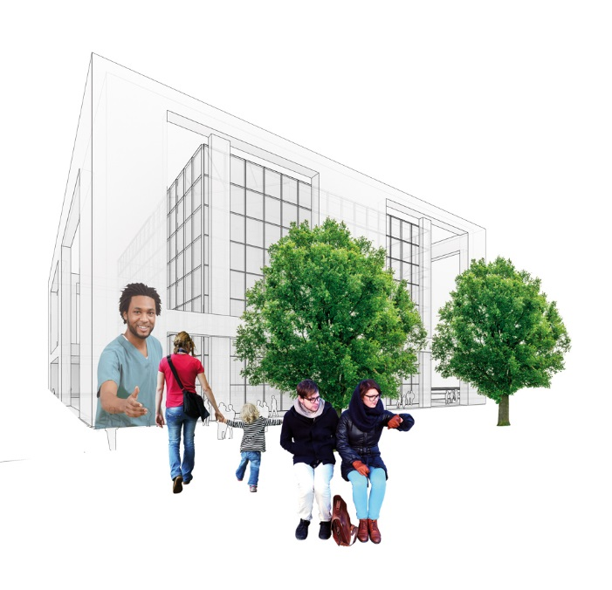
Notes:
In the ERA-NET Cofund Smart Urban Futures Call cities and civil society in Europe can address urgent and long-term challenges by co-creating ideas and projects.
The fourth call from the Joint Programming Initiative Urban Europe with financial support from Horizon 2020
Joint Programming Initiative Urban Europes initiates joint transnational calls in research, development and innovation in the field of sustainable urban development.

