Slide 1
Project SIRIUS
JPI Sustainable and Liveable Cities and Urban Areas
Kick-off meeting
Oslo, May 2019

Slide 2
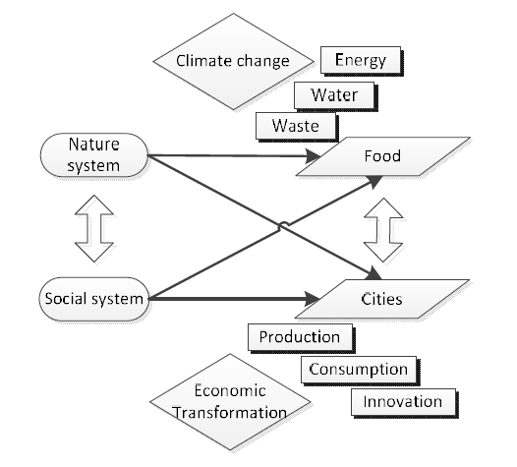
Visions

Slide 3
Visions

Slide 4
Aims
Sustainable, Innovative, Resilient and Interconnected Urban food System

Slide 5
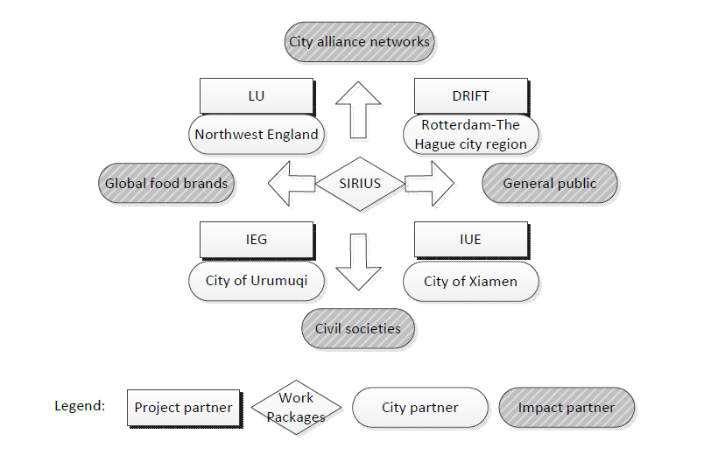
Impacts

Slide 6
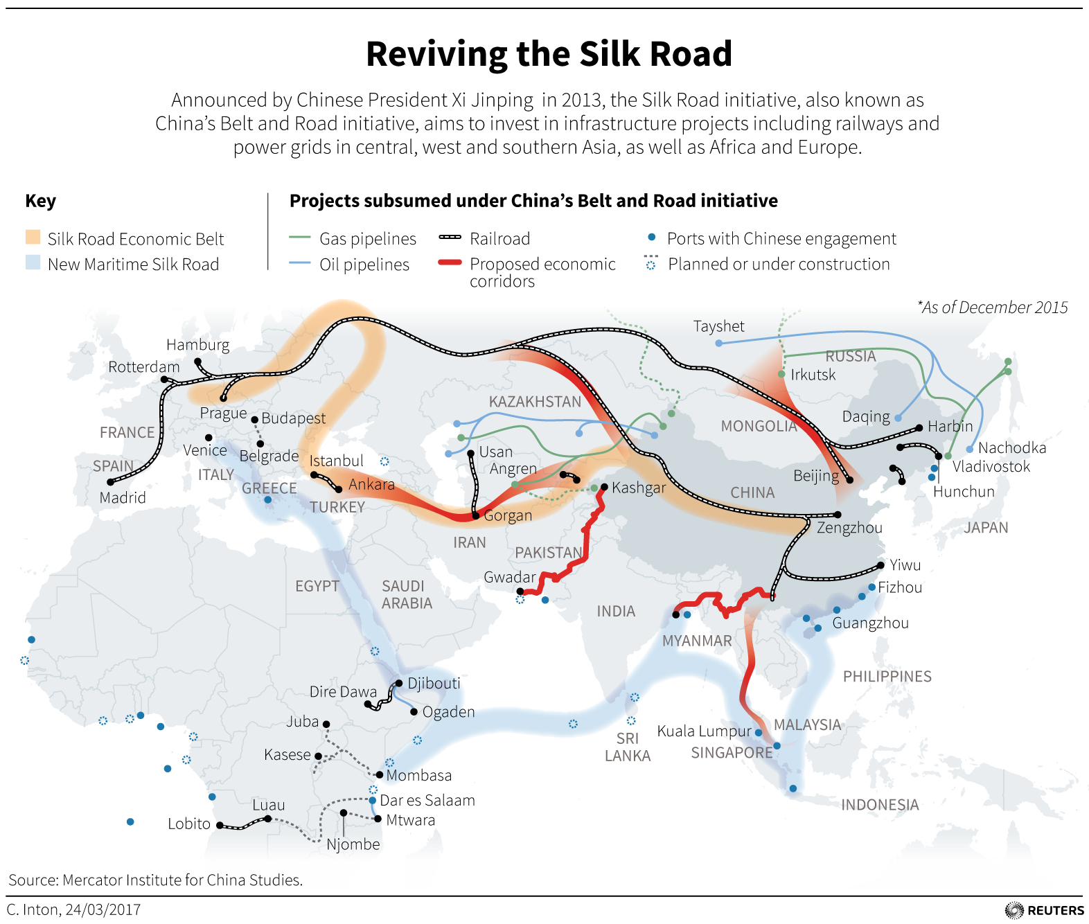
Impacts

Slide 7
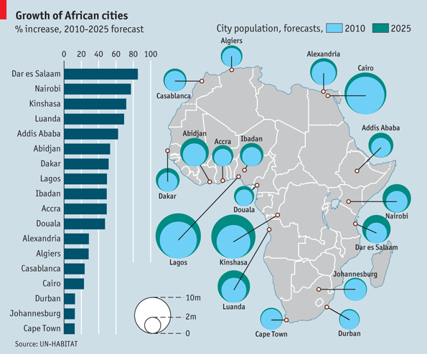
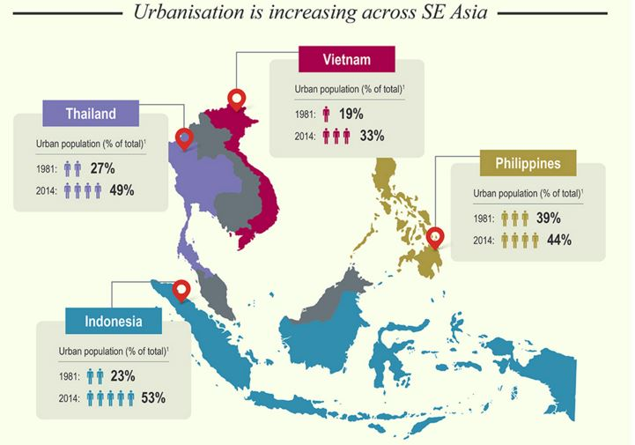
Urbanization in Africa and SEA
Impacts
Source: The Economist
Source: NTU

