Slide 1
Dr. Daniela Melandri
Innovate UK

Slide 2



SUGI
The Sustainable Urbanisation Global Initiative (SUGI)/Food-Water-Energy Nexus is a joint call initially defined between the Belmont Forum, the JPI Urban Europe and the European Commission, established in order to bring together actors to find innovative new solutions to the Food-Water-Energy Nexus challenge. The African Start Alliance has joined the call at a latter moment.
The ultimate goal is to increase the access and the quality of life in the Urban landscape.

Slide 3
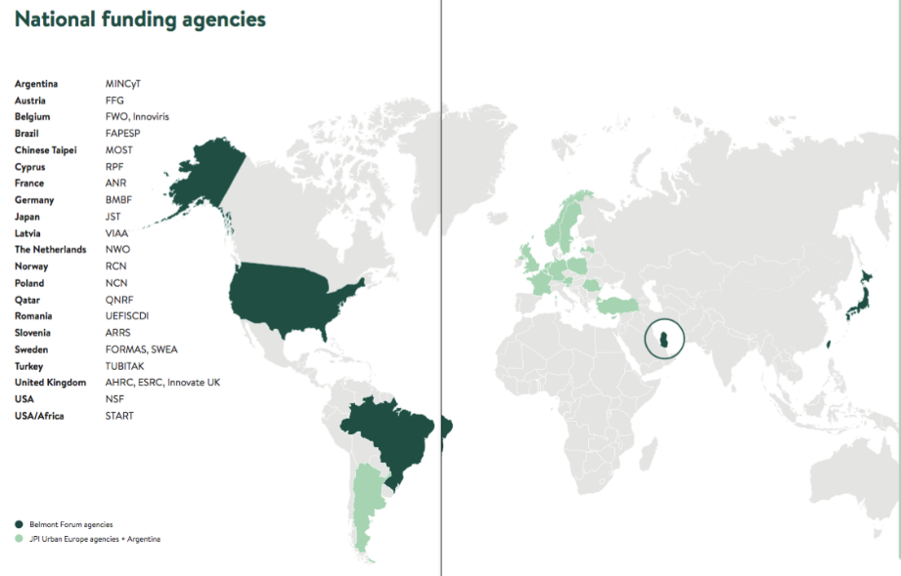
Geographical Coverage
26 Funding Agencies 20 Countries + All African PIs
TOTAL Budget
including EC top up
ca 30 M€
Notes:
Ask funding agencies to standup and put faces to names

Slide 4
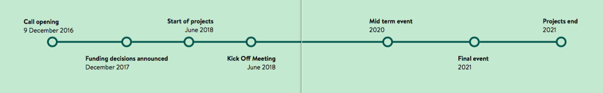
Timescale

Slide 5
Topic 1: Robust knowledge, indicators and assessment
About the call: themes
Topic 2: Multi-level governance and management
Topic 3: Managing strategies and solutions
Notes:
Concepts and strategies for smart urban transformation, growth and shrinkage
While patterns of transformation growth and shrinkage pose challenges to cities across Europe they also offer opportunities.The projects should create a better
understanding of the interplay between cities and their surrounding rural areas in
terms of land-use, transport, environment, energy, identify how transformation,
growth and shrinkage dynamics can be exploited as an opportunity to revise spatial structures, decision processes and stakeholder cooperation and strengthen favourable practices towards better livelihoods and quality of life.
New dynamics of public services
In recent decades many urban areas in Europe have seen a significant change in the structure and organisation of public service provision. Recent game-changing circumstances and dynamics stemming from economic, social and environmental trends intensify the necessity to rethink traditional models. This topic aims to
develop new and innovative approaches in the realm of public services to increase
the capacity of urban areas to answer local challenges.
Inclusive, vibrant and accessible urban communities
This topic examines the everyday needs and challenges facing different social and cultural groups in the city, and how individual and community practices, urban governance, businesses, infrastructures and urban regeneration can support sustainable urban development and the peaceful integration of diverse communities.

Slide 6
About the Joint Call: Scope and Expected Impacts
Solution and Innovation oriented
In the Sustainable Urbanisation Global Initiative (SUGI) Food-Water-Energy Nexus Call international projects are expected to develop solutions targeting the Food-Water-Energy Nexus challenge.
Cross-disciplinary and cross-sectoral cooperation
Projects are expected to develop cross sectoral cooperation (within the consortium and with external actors) to ensure participants across natural sciences (including engineering), social sciences and arts and humanities as well as policy and decision makers and stakeholders around the world.
Global cooperation
The projects are expected to deliver impacts and solution through international collaborations with at least three countries
Notes:
In the ERA-NET Cofund Smart Urban Futures Call cities and civil society in Europe can address urgent and long-term challenges by co-creating ideas and projects.
The fourth call from the Joint Programming Initiative Urban Europe with financial support from Horizon 2020
Joint Programming Initiative Urban Europes initiates joint transnational calls in research, development and innovation in the field of sustainable urban development.

Slide 7
About the Projects: Expectations
Innovation projects: Implementation, demonstration, testing and uptake of approaches for new products, services, policies, practices, and processes, with potential for improving economic, social, or environmental sustainability in cities.
The ultimate goal is to rapidly evolve the knowledge base, advance indicators and assessment tools that are needed for a comprehensive understanding of the FWE nexus, and develop practical new solutions to the FWE challenges.
Projects must address all three sectors food, water and energy by an integrative approach.

Slide 9
Implementation Team
Call Secretariat
NSF
NWO

Slide 10
Contact
Dr. Daniela Melandri
Innovate UK
support@innovateuk.ukri.org
info@jpi-urbaneurope.eu

