Slide 2
Reporting and other formal requirements

Slide 3
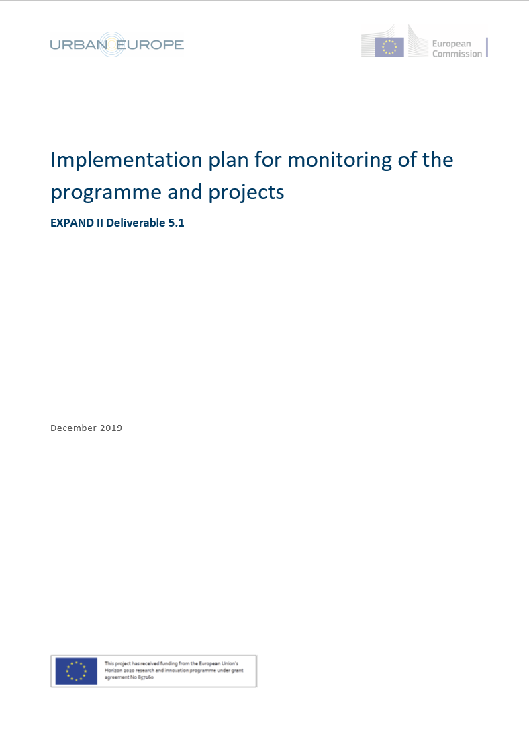
Reporting
1. Transnational reporting
JPI Urban Europe developed an implementation plan for programme and project monitoring in 2019
After consultation with the BF, reporting via BFgo has been changed accordingly
2nd transnational report due mid-June 2020
3rd (final) transnational report will be due mid-June 2021 – will comprise additional questions related to project finalisation, innovation and impact creation

Slide 4
Reporting
2. National reporting
The funding obligations on national level are specified in the contracts of the project partners with their respective national/regional funding agencies.

Slide 5
Project Extensions due to COVID-19
Call Management Team is very much aware of the COVID-19 impacts on project progress
Under the current circumstances and because of the European ERA-NET funding scheme, project extensions can be granted up to a maximum of 6 months
Please get in touch with the Call Secretariat: johannes.bockstefl@ffg.at Judit???

Slide 6
Data Management
Data management plans are obligatory in the SUGI call.
They should include information on:
the handling of research data during & after the end of the project
what data will be collected, processed and/or generated
which methodology & standards will be applied
whether data will be shared/made open access and
how data will be curated & preserved (including after the end of the project).
More information is available on
webpage of the Belmont Forum www.belmontforum.org (Open Data Policy and Principles), template was annex in the call
European Commission http://ec.europa.eu/research/participants/docs/h2020-funding-guide/cross-cutting-issues/open-access-data-management/data-management_en.htm

Slide 7
Contact
Johannes Bockstefl FFG – Austrian Research Promotion Agency johannes.bockstefl@ffg.at

