Slide 1
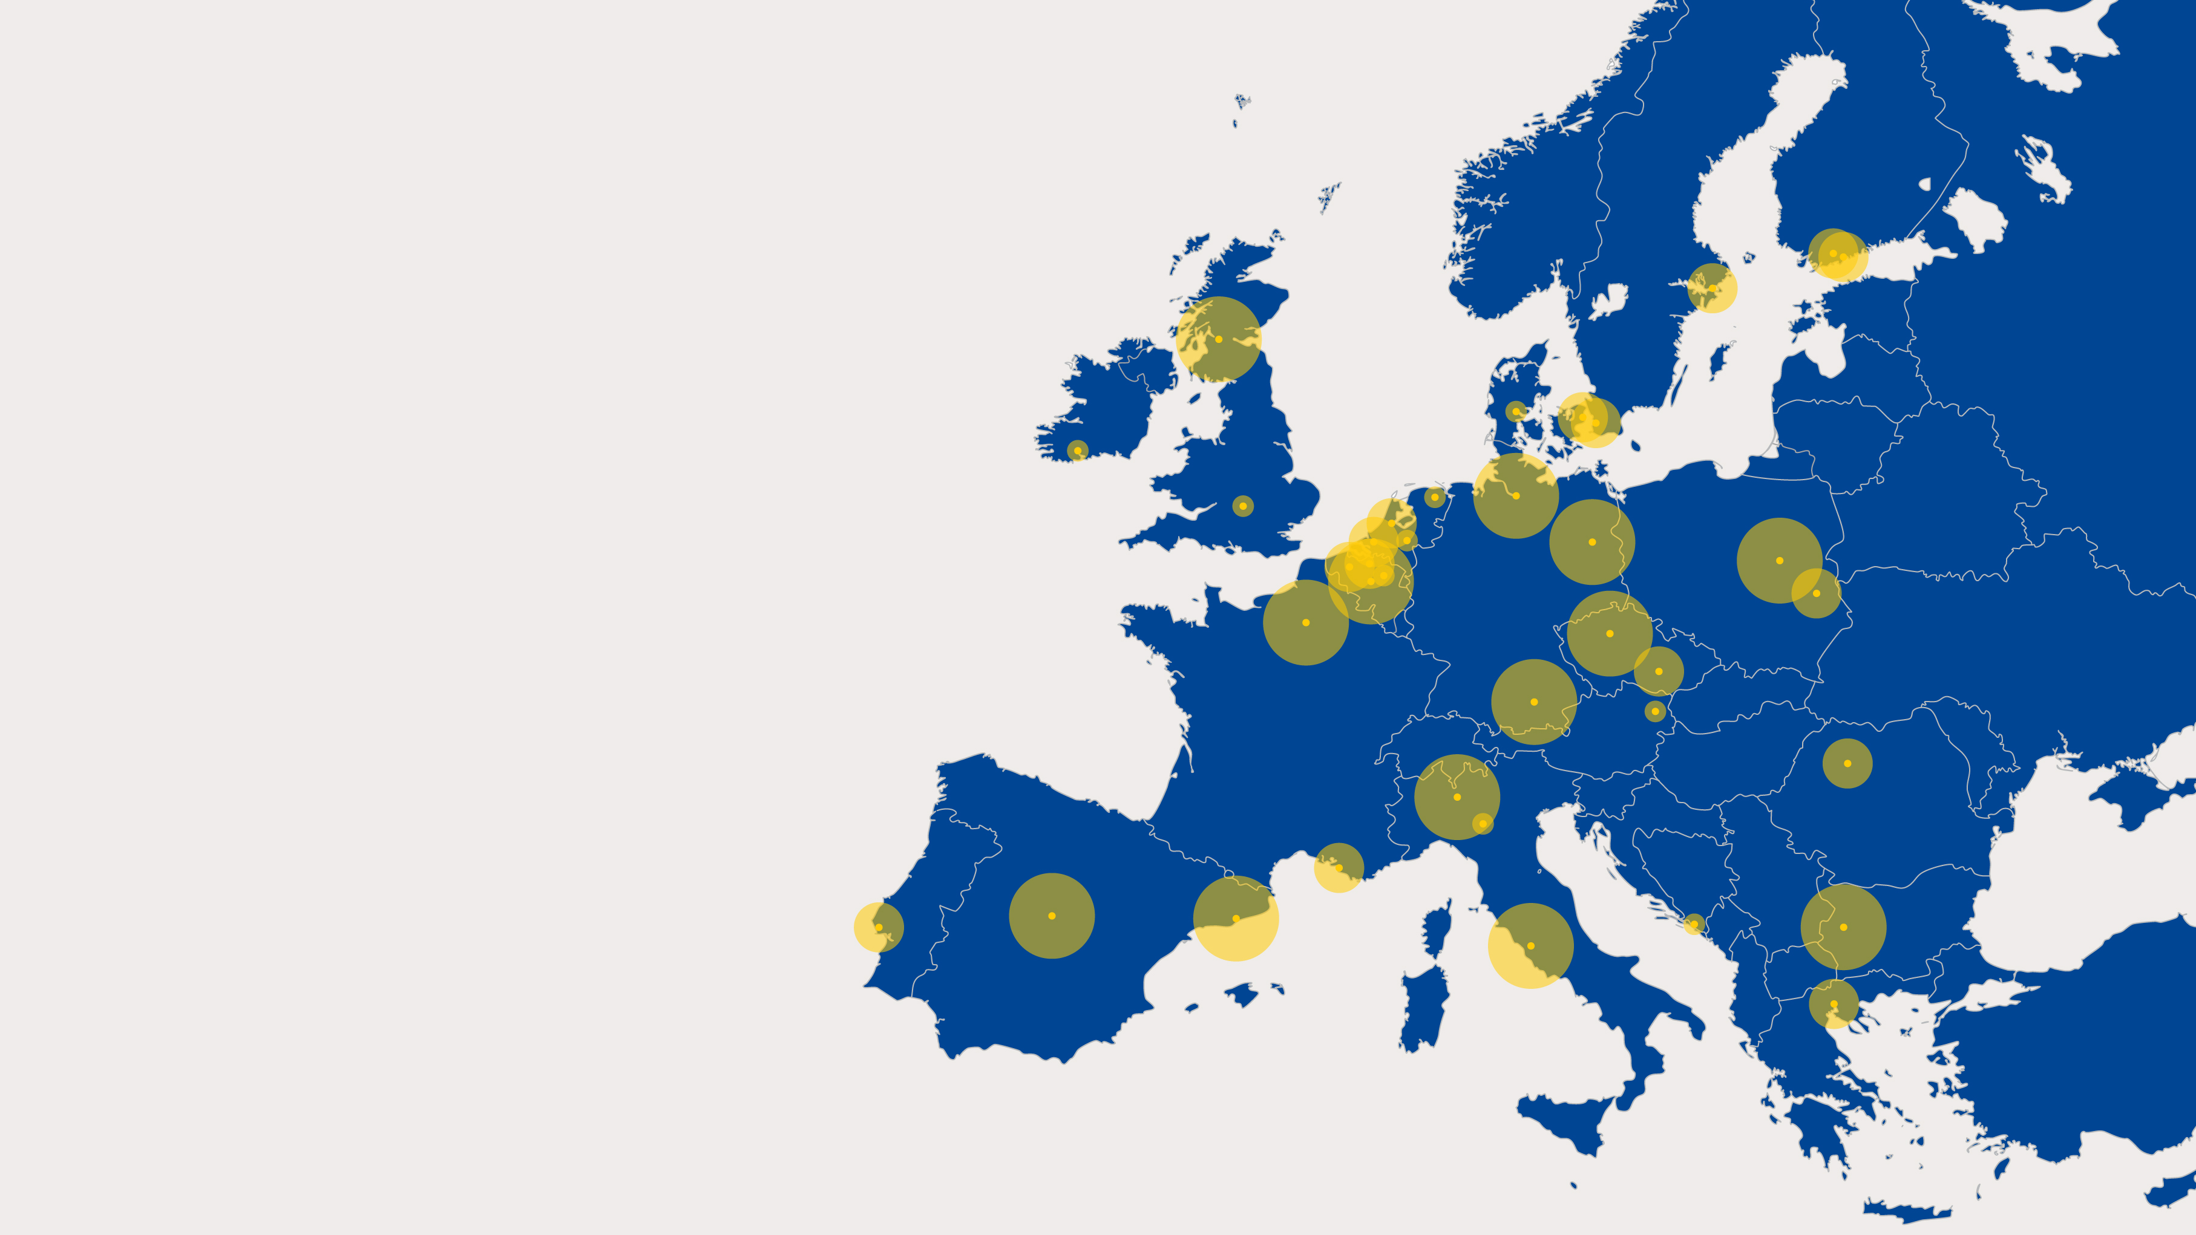
City Science Initiative, 2020
CITY
SCIENCE
FOR
URBAN
CHALLENGES
Pilot assessment and future potential of
the City Science Initiative
2019 – 2020
Caroline Navejan

Slide 2
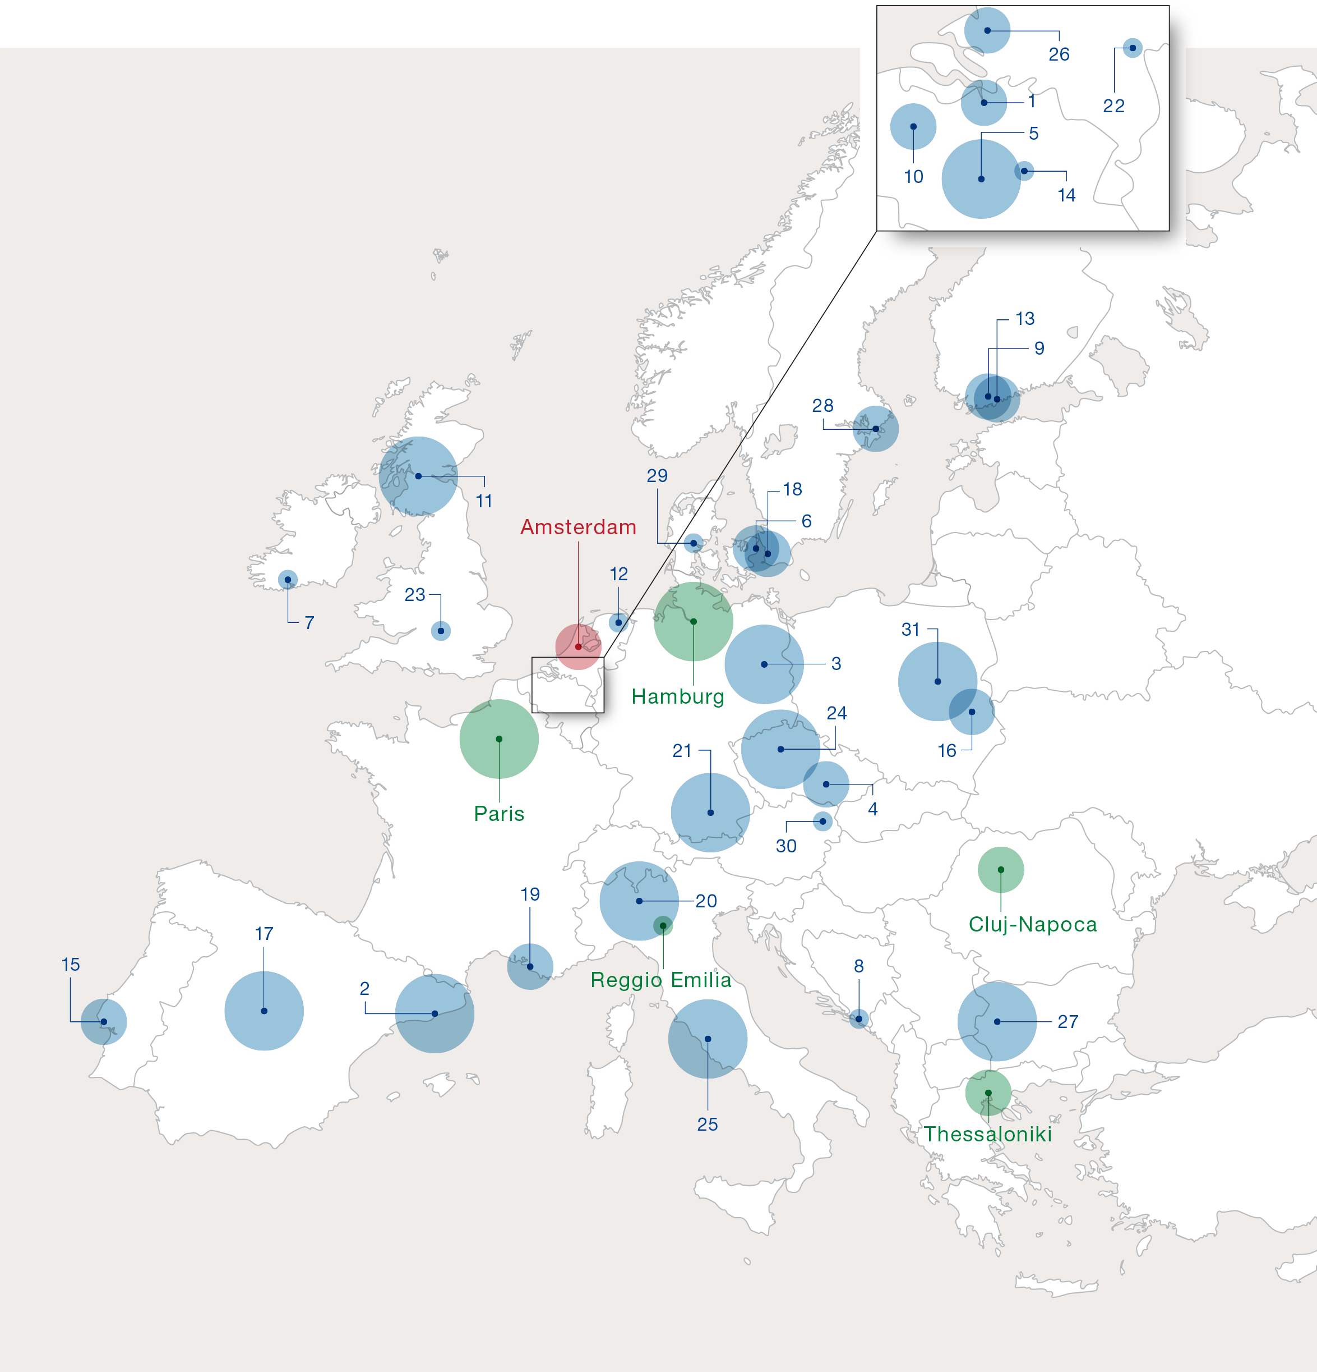
2
STAKEHOLDERS:
CITIES

Slide 3
3
STAKEHOLDERS:
NETWORK
STAKEHOLDERS:
EUROPEAN COMMISSION
EUROCITIES
100 Resilient Cities
Covenant of Mayors
European Network of Living Labs (ENoLL)
European Regions Research and Innovation Network (ERRIN)
European Union Knowledge Network (EUKN)
UN Global Sustainability Index Institute Foundation (UNGSII)
ICLEI
International Urban Cooperation
JPI Urban Europe
ThinkNature
UNICA: Network of Universities from Capitals of Europe
URBACT
JRC
DG Research & Innovation
DG REGIO
DG CLIMA
DG CNECT
DG ENER
DG ENV
DG GROW
DG MOVE
EASME

Slide 4
CSI PILOT TIMELINE

Slide 5
5
CITY SCIENCE
Challenge based
The city as complex system
Integral nature of challenges
Different kinds of knowledge for solutions
Transdisciplinary in research questions
Design contributing to the science-policy interaction
Cities acquire data professionally
Universities develop international reviewed methodologies
Every step in research process is influenced by complexity of city challenges

Slide 6
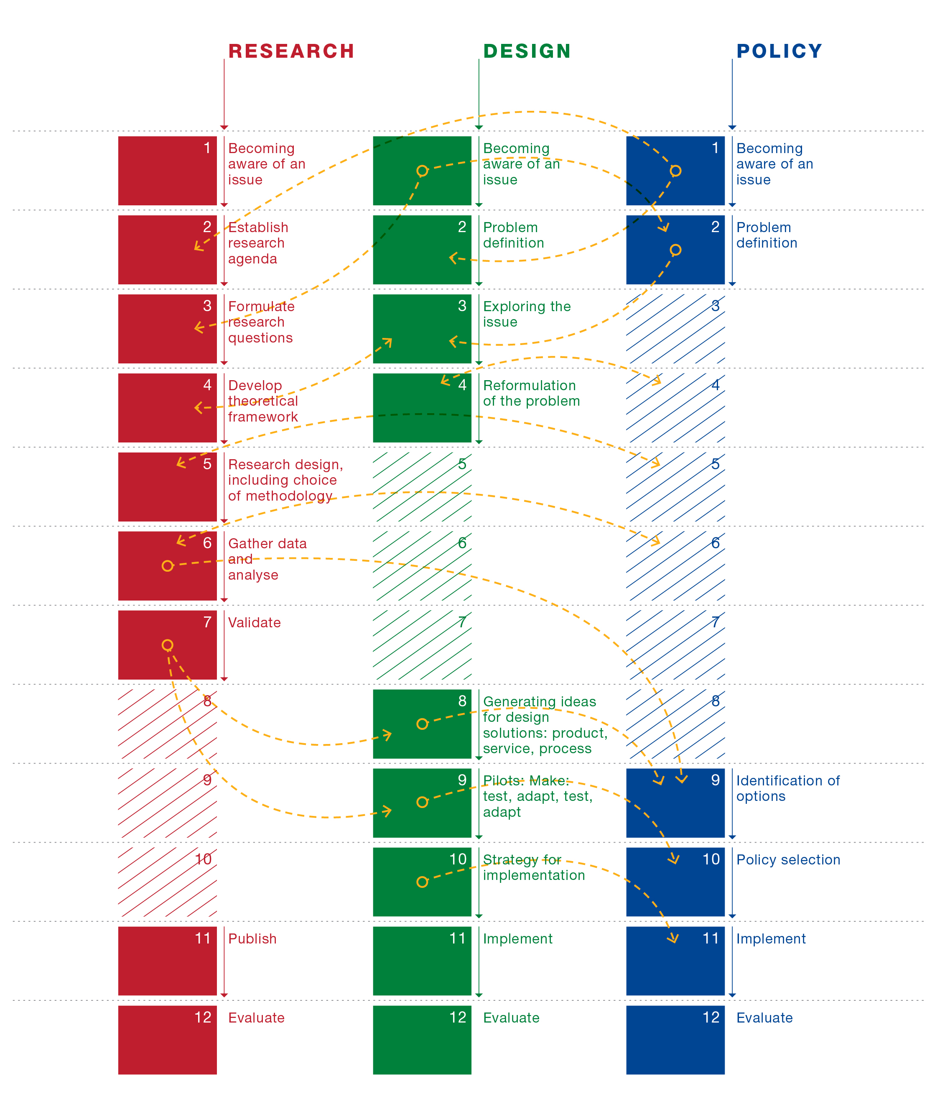
6
CITY SCIENCE
DYNAMICS

Slide 7
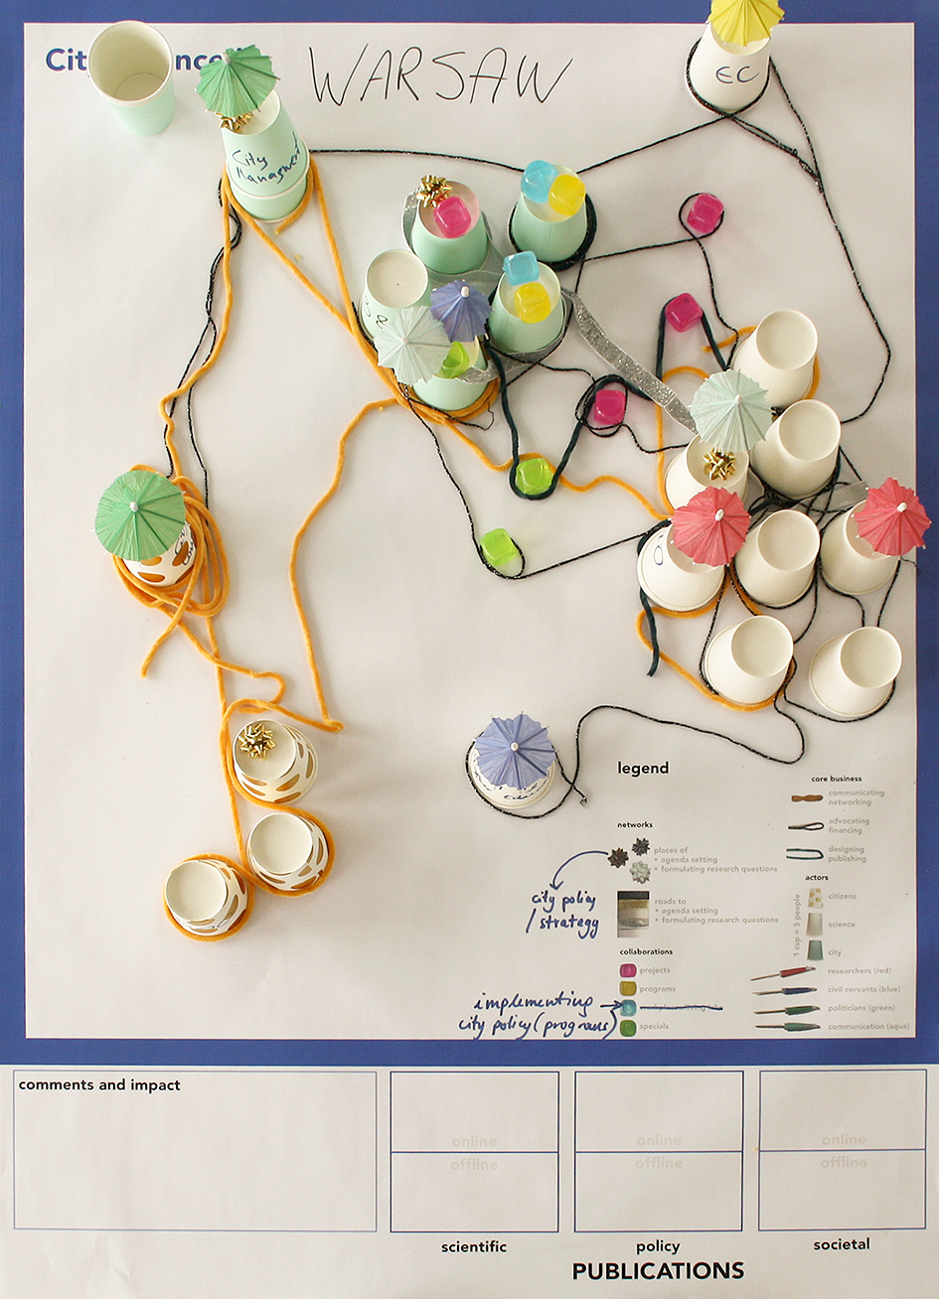
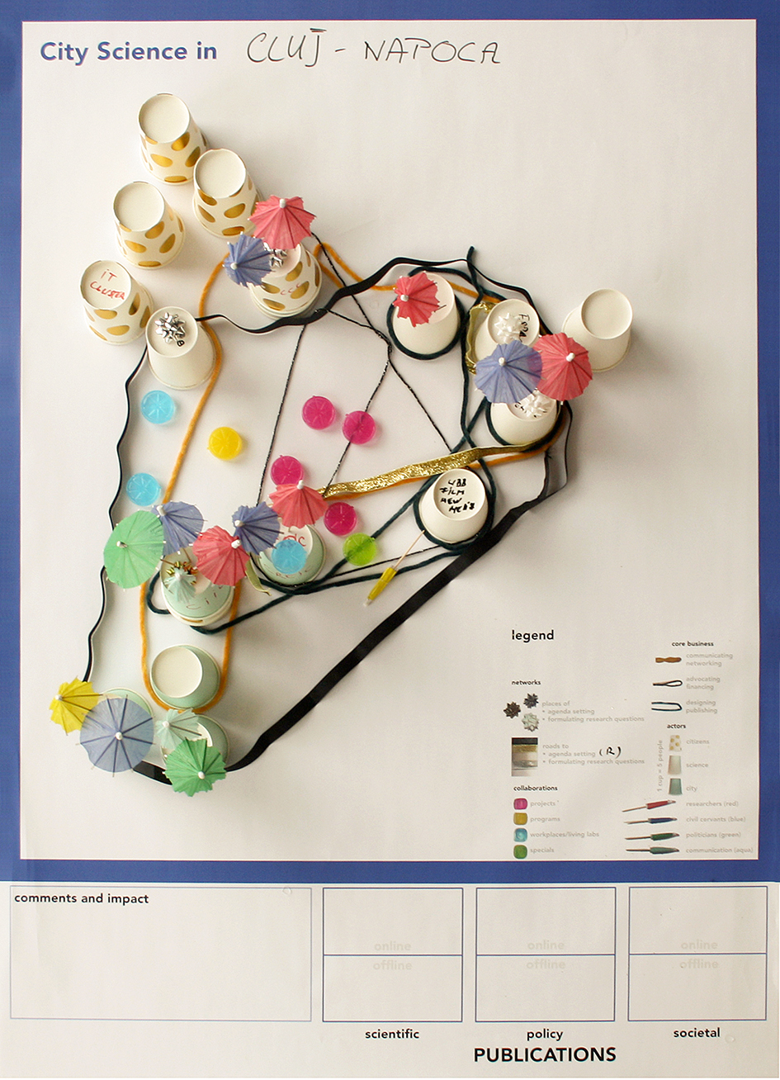
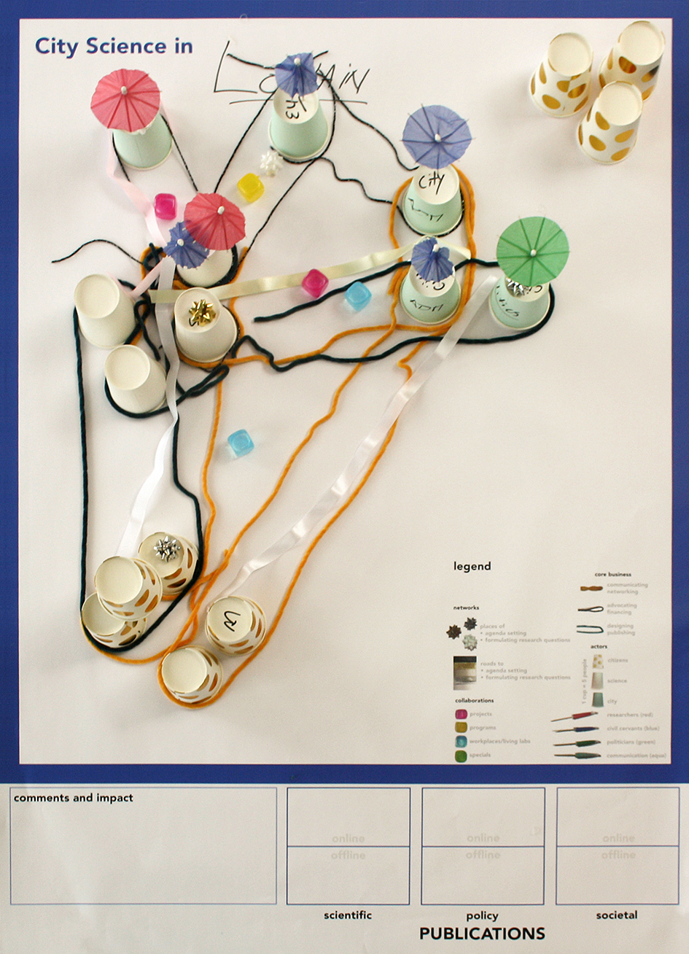
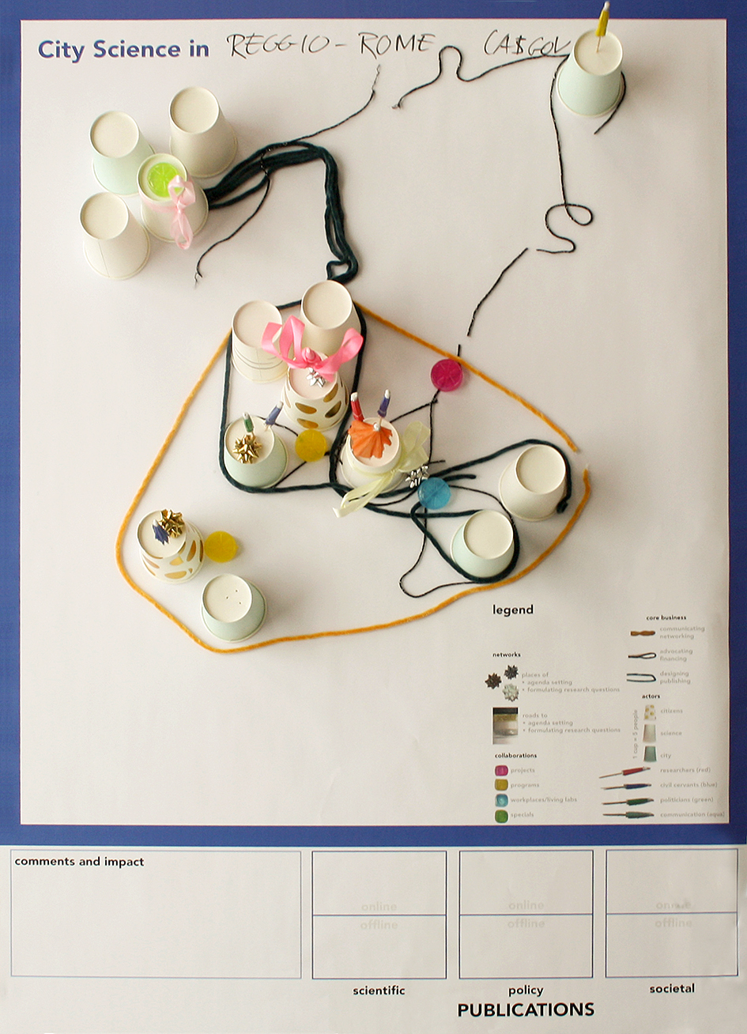
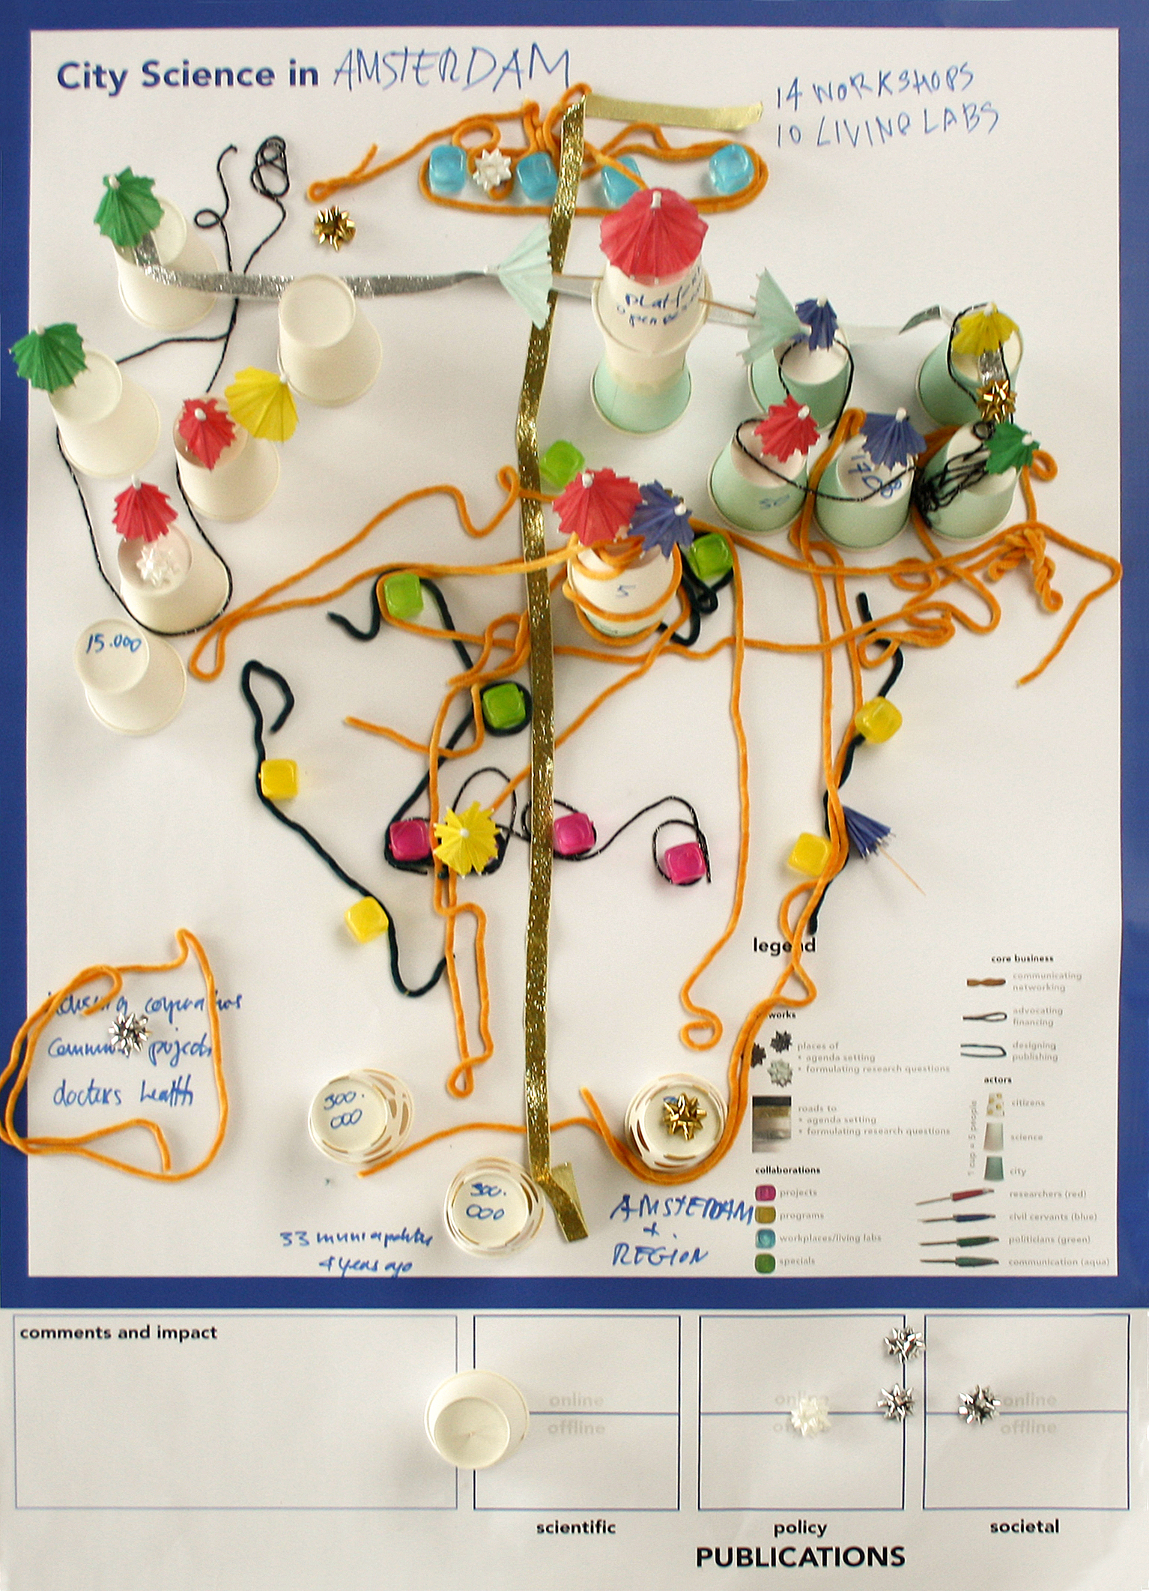
7
MAPPING CITY SCIENCE PRACTICES
Warsaw
Cluj-Napoca
Lublin
Reggio Emilia
Amsterdam

Slide 8
8
CITY SCIENCE ISSUES
Governance and finance of City Science
Learning and communication between science and policy
A need for a new research paradigm on City Science
Need for data exchange
Agency of city

Slide 9
9
THEMATIC WORKSHOPS
CIRCULAR ECONOMY
Hamburg
SUSTAINABLE URBAN MOBILITY
Cluj-Napoca
AIR QUALITY
Paris
TECH AND THE CITY
Reggio Emilia
MENTAL HEALTH Thessaloniki

Slide 10
10
CSI ASKS TO:
Improve the relevancy of European research for city challenges
Give more support in translating the findings of European research into applicable solutions
Improve the uptake of research on the local level
Solve the lack of access to data is seriously impacting the possibility to make fact-based policies
Make stronger supporting instruments to improve cooperation between cities themselves, universities and the Commission

Slide 11
11
CSI POTENTIAL:
CSI is a communication environment for EU research results
CSI is a learning environment for City Science practitioners
CSI is a sounding board for networks, JRC and EU DG’s
CSI is a catalyst for generating challenge based research questions and designs
CSI is a bridge to transdisciplinary urban research between different DG’s in addressing city challenges
CSI is a manifestation in cities of European way of life to which evidence based policymaking is core

Slide 12
12
LETTER FROM
MAYORS
Given the societal urgency to find innovative approaches and solutions to the challenges European citizens will face in the coming years, we believe that there is a need to continue the City Science Initiative as a learning platform for urban research.
We can assure you that our cities stand ready to support the next phase of the CSI.
Marie-Christine Lemardeley
Deputy Mayor of Paris
Emil Boc
Mayor of Cluj-Napoca
Konstantinos Zervas
Mayor of Thessaloniki
Luca Vecchi
Mayor of Reggio Emilia
Almut Möller
State Secretary of Hamburg
Femke Halsema
Mayor of Amsterdam

Slide 13
City Science Initiative, 2020
Amsterdam
Antwerp
Barcelona
Berlin
Brno
Brussels
Cluj-Napoca
Copenhagen
Cork
Dubrovnik
Espoo
Gent
Glasgow
Groningen
Hamburg
Helsinki
Leuven
Lisbon
Lublin
Madrid
Malmö
Marseille
Milan
Munich
Nijmegen
Oxford
Paris
Prague
Reggio Emilia
Rome
Rotterdam
Sofia
Stockholm
Thessaloniki
Vejle
Vienna
Warsaw
Thank you
For more information: Roel Raterink r.raterink@amsterdam.nl
Report download: https://openresearch.amsterdam/nl/page/63027/city-science-for-urban-challenges

